Slide 1



Adobe commerce Rockstar 2025
EDS Drop-in: Search powered by Google Vertex AI

Slide 2





Today’s solution presentation & demo
Understanding Retail Search challenges
Our Approach to the Problem
Vertex AI search for Retail
Technical Architecture, Vertex AI
Today vs Tomorrow : Potential outcome

Slide 3



Understanding the Retail search, their challenges and goals
Retail search without AI has several limitations, as traditional search engines rely on keyword matching, static rules, and predefined filters. These limitations can impact the overall customer experience and conversion rates.
Pain points & frustrations
Goals & motivations
Exact keyword dependency
Cannot interpret broader intent
Failed to adopt individual user trends
Search results not shown based on the user preferences or behaviour.
Limited scalability with large size catalogue.
No visual search – Style or Pattern
Inadequate cross selling and upselling
Search results based on user purchase history, browsing pattern and demographic data.
NLP processing support in AI
Visual and voice search support
Continuously learning from new ingested and set priority
Enable more granular filtering based on search query
Handle partial matches, suggest similar products/categories
Improved Security and Compliance

Slide 4
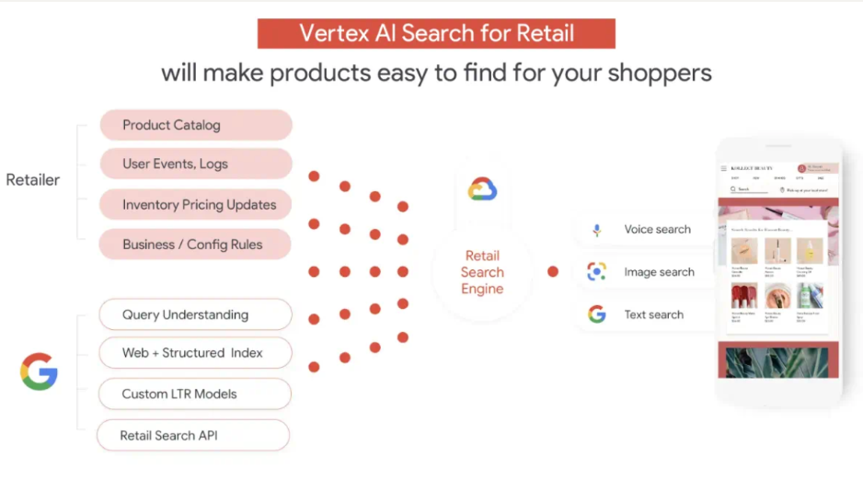
Why we chose Vertex AI Search
With Vertex AI Search for Retail solution (formerly known as Discovery AI), enterprises can provide Google-quality search, browsing and recommendations on their digital properties, increasing conversions and reducing search abandonment.
Key Features
Advanced AI: Google’s AI powers semantic search, personalization, and precise query matching for fast, relevant discovery.
Optimized Outcomes: Use ranking models and business rules to customize results for engagement, revenue, or conversions.
Fully Managed: Automated infrastructure handles traffic spikes and integrates seamlessly with tools like Google Analytics and BigQuery.
https://www.valtech.com/en-in/blog/google-cloud-retail-search/

Slide 5





Vertex AI Search for Retail: Opportunity Potential
Retail Search user will receive autocomplete suggestion based on the google search and browsing history in past. Catalog & event data ingestion would train vertex AI model.
01
Vertex AI search for Retail
Recommendations AI is using same ingested data prepared for the Retail search and model need not to be trained to get product recommendations from AI.
02
03
Vision Product Search is using computer vision algorithms & deep learning model to extract – pattern, color, textures, shapes
Notes:
3000+ AEM Customers (Sites, Assets, Forms, Screens, Learning Manager, AEM Guides)
Over 700 licensed CS customers,
over 800 MS customers
Over 1500 on-premise term customers to target
AEM Sites +Assets + Forms (Abbott Laboratories, NCR Voyix, NVIDIA, Walmart)
AEM Sites+Assets (Charter Communications, Starbucks, Mitchell International, HP, Intel, Expedia, FedEX)
AEM Sites (Colgate-Palmolive, Hewlett Packard Enterprise (HPE))
AEM Assets (Lamps Plus)
AEM Forms (FedEx Corporate Services)
10-12 MM TAM for Migration for existing customers
1B for NN
Cloud-native. Adopt cloud-native applications with global scale, speed, security, and a lower TCO.
Latest Innovations. Leverage powerful integrated tools to deepen customer relationships and expand market value.
Rapid Experience Delivery. Mobilize teams to create experiences that are personalized, intelligent, and impactful.
Developer Velocity. With a Cloud Manager and a native CI/CD pipeline enable great agility and time to market.
Lower Total cost of Ownership. Save on the direct costs of hosting, network maintenance, security, and upgrades.

Slide 6
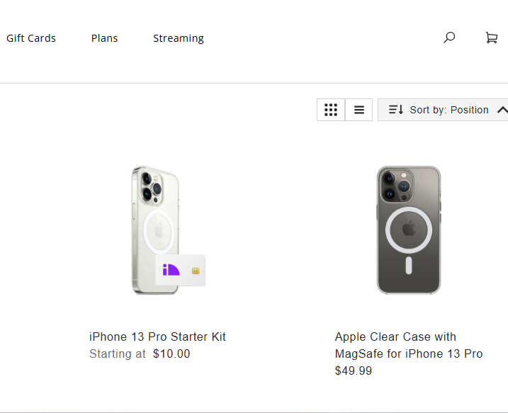
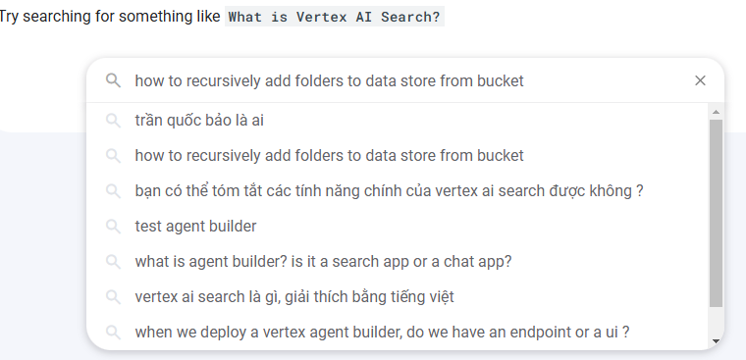
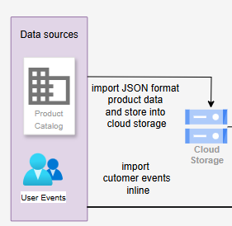
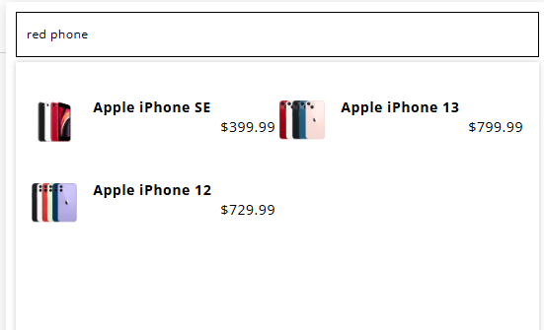
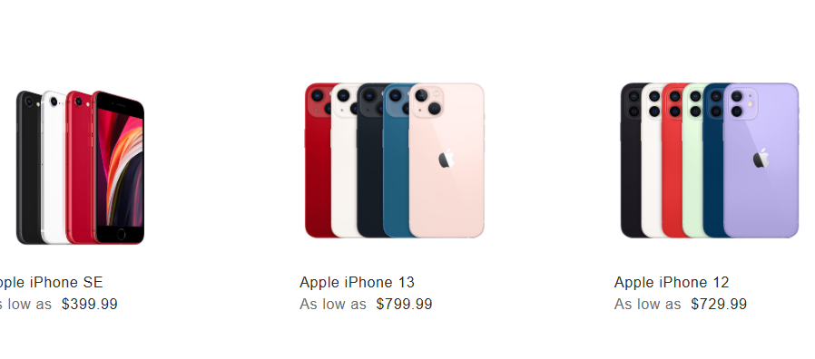



Our approach towards the problem
User Experience
Launch retail storefront
Search product based on textual pattern
Take data input and send to cloud storage/retail API
Retail search AI prepared results based on trends, browsing or purchase history
User will be able to get desired search result
Commerce EDS storefront
Process search term via rest API
Import product & event data into cloud storage/retail API
Vertex AI generate results
Commerce EDS search module render result on storefront
Features
Commerce EDS
Vertex service configurations
JSON, Rest API, product data, events data ingestion
Vertex AI, Machine learning Algorithm
Rest API, Vertex AI
How did we do?

Slide 7
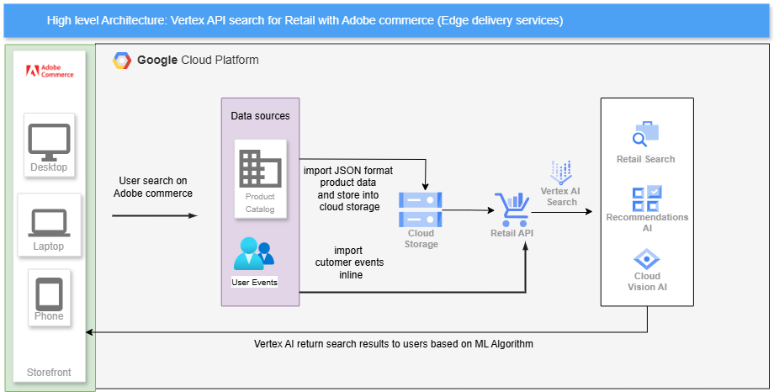
High level technical architecture

Slide 8
Demo

Slide 9

Today vs Tomorrow – potential outcome
Today – without vertex AI
Tomorrow – with Vertex AI
Suboptimal customer experiences
Enhance customer search experience by providing better search results with Vertex AI
Limited search accuracy
Contextual and synonyms provides accurate search results
Lack the ability to adapt to individual user preferences or real-time behavior
Real time learning from user browsing history and trends and improves vertex AI search Algorithm.
Business benefits
50%
90%
40%
Customer Experience
Accurate Search Results
More Revenue growth

Slide 10
Let’s talk!
Q & A

